Slide 1
Autodesk Vault Workgroup | Professional | Office
Vault Data Standard – Configuration Editor
Markus Koechl
Solutions Engineer PDM|PLM – Autodesk Central Europe

Slide 2
Agenda
Overview
Scope and Benefits
Download & Subscribe
Get Started
Visual Studio | PowerShell Extension | File Differ
Setup Visual Studio
Use Case Examples
Best Practice – Change Default Script to Custom Script
Add Configurations
Adding Folders
Adding Branches
Evaluate Vault API

Slide 3
Overview
Scope | Benefits | Availability

Slide 4
VDS-ConfigurationEditor | Scope & Benefits
Edit any VDS Configuration Files/File Types
Manage Configuration File Links/Configuration
Evaluate Vault API Commands
Watch Variables
Review Default Configuration
Review Quickstart Configuration
Edit & Compare Configurations
Reuse Code from Sample Scripts
Reuse Snippets from Libraries
Add Custom[er] Configurations
Reuse 2018.1 template
Reuse 2019 template
…get 20xx templates as follower

Slide 5
VDS-ConfigurationEditor | Supported VDS Versions
One Single Solution supporting
VDS 2018.1
VDS 2019
… and future releases
Switch seamlessly from VDS-2018-Advanced-Configuration-Editor
No Change in Existing Template & Snippet Structure
New API Evaluation Projects
API 2018 References & Help
API 2019 References & Help
New VDS Version Projects
Referencing libraries accordingly

Slide 6
VDS-ConfigurationEditor | Download & Subscribe
GitHub Repository
Adds any valuable updates / enhancements to the branch master
Link - https://github.com/koechlm/VDS-Configuration-Editor
Follow Me – stay informed about new commits
Updates
New Snippets
New Templates
Need to Know – Clone the Visual Studio project to the drive your Program Data tree resides. Usually this is C:\Program Data. Users running all program installations on D: have to clone the Editor project to a D: drive location respectively, as configuration file links are relative paths in the Editor Project.

Slide 7
Get Started
Setup Visual Studio Environment

Slide 8
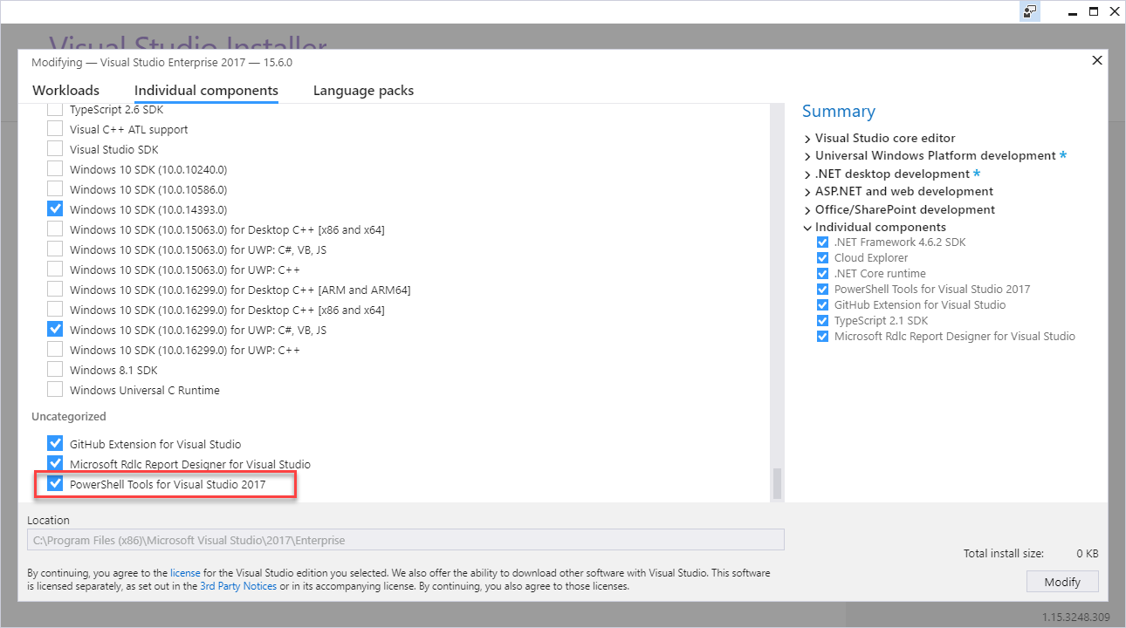
Setup | Visual Studio 2017
Add/Modify – PowerShell Extension

Slide 9
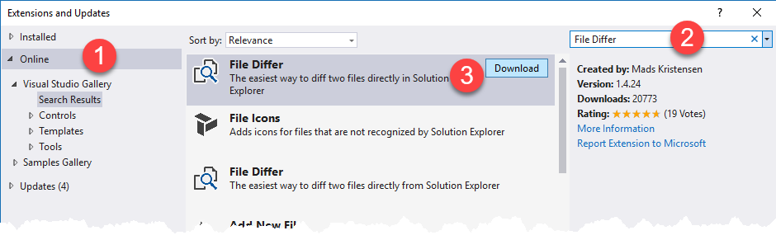
Install | Visual Studio 2015 or 2017 Editions
Add/Modify – PowerShell Extension
[Optional] Add File Differ
[Optional] Add Source Control
Note – VDS-ConfigurationEditor manages links and not the current configuration files!

Slide 10
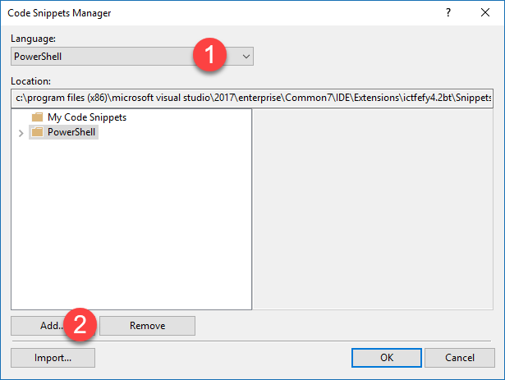
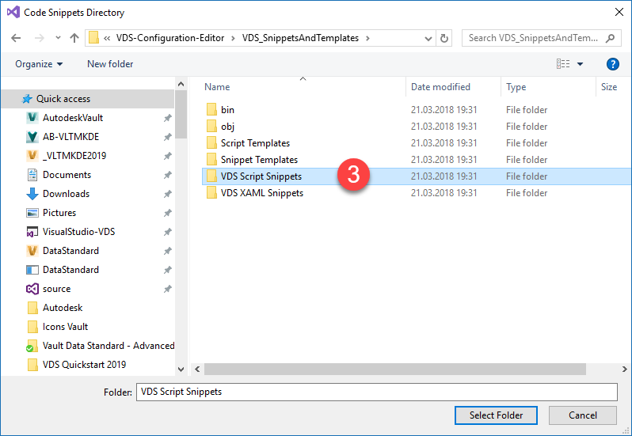
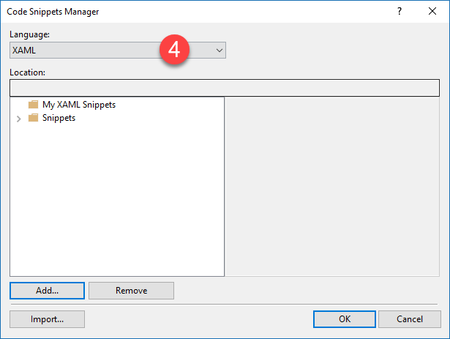
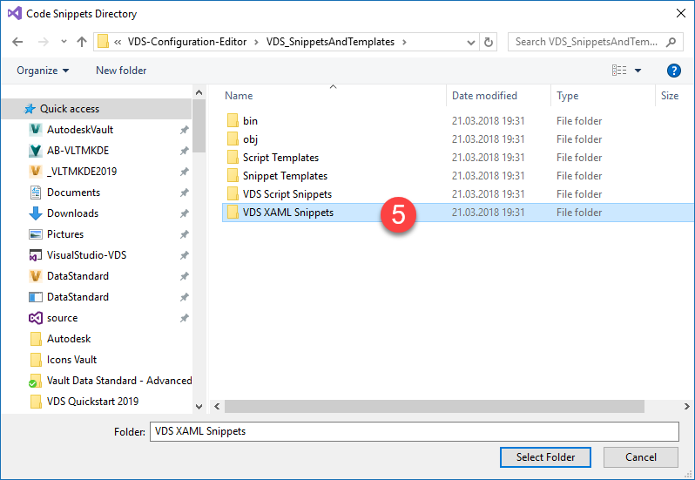
Setup | Code Snippet Manager
Add Powershell and XAML Snippets
Tools -> Code Snippets Manager
Select PowerShell / Add…
Select XAML / Add…

Slide 11
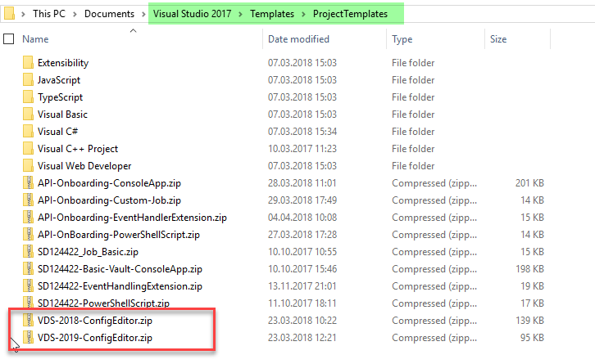
Setup | VDS Editor Templates
Add VDS 2018.1 and VDS 2019 Project Templates
Copy *.zip files to Visual Studio project templates

Slide 12
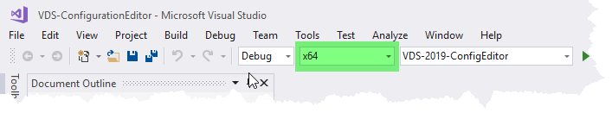
Setup | VDS Editor Template 2019
Note – Starting with 2019 VDS dlls are compiled for x64 CPU instead of AnyCPU. As a result, the editor configuration requires switching to x64.

Slide 13
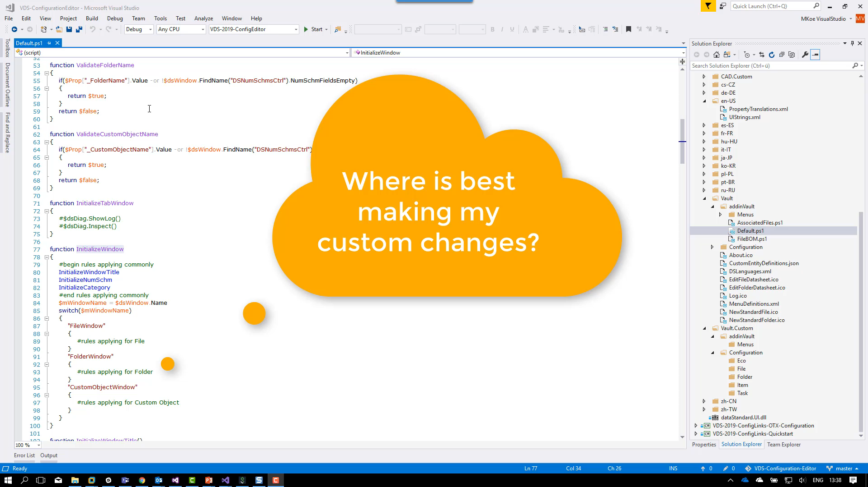
Edit Configuration | Example
How to edit a VDS 2019 RTM Configuration?

Slide 14
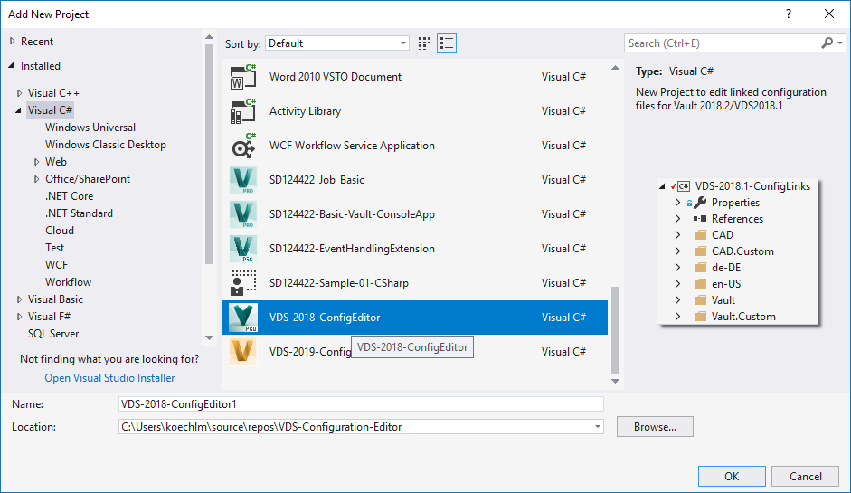
Create New Configuration File Set
How to edit a custom configuration file set?
You don’t know the configured files / file names?
Solution
Add New Project -> Select Template
Drag & Drop Configuration File Set
NOTE – Press ALT key while dragging!

Slide 15
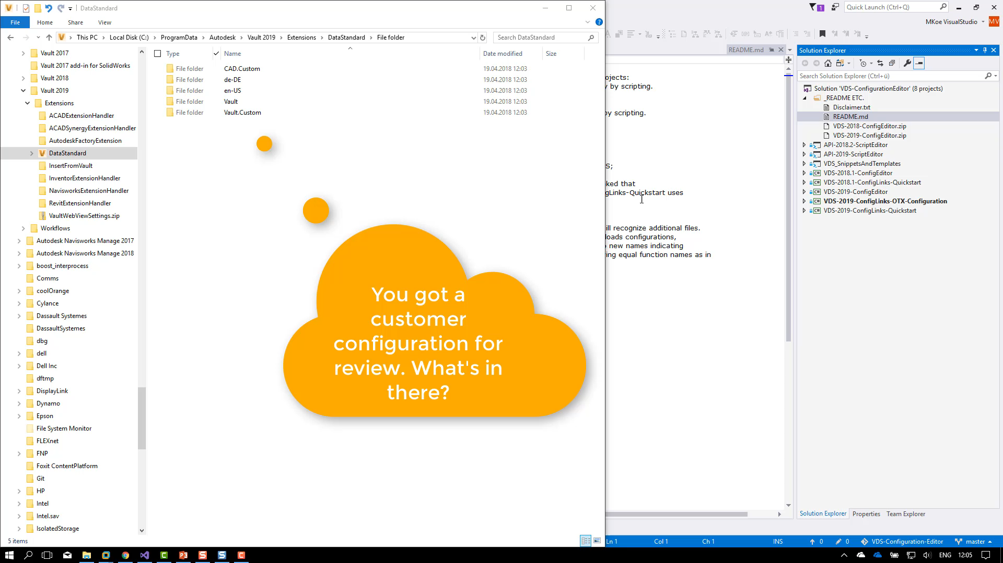
Create New Configuration File Set
How to edit a custom configuration file set?
You don’t know the configured files / file names?

Slide 16
Best Practice

Slide 17
Change Default Script to Custom Script
How to compare with default later on?
Example – Customize the CustomObject Dialog
Legacy Solution Approach
Edit existing file .\Vault\Configuration\CustomObject.xaml
Solution Approach #1
Copy original file to .\Vault.Custom\Configuration\CustomObject.xaml
Edit this file…

Slide 18
Change Default Script to Custom Script
Compare VDS Quickstart 2019 Configuration
Example – Customize the CustomObject Dialog
Solution Approach #2
Copy original file to .Vault.Custom\Configuration\MyCustomObject.xaml
VDS will continue to load the default one…
Customize Create*.ps1 and Edit*.ps1 to enable the new one!
Copy *ps1 files to .\Vault.Custom\addins\Menus\
Assign $dialog.XamlFile to the new path & file name
Adopt *.ps1 names in MenuDefinition.xml if renamed

Slide 19
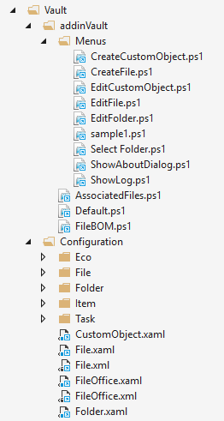
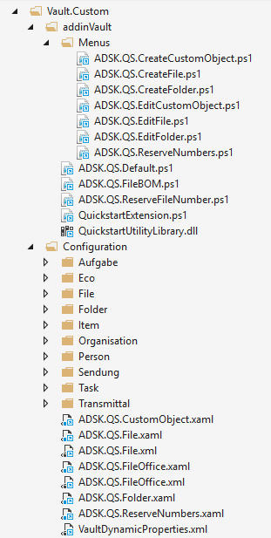
Quickstart 2019 | Compare Changes – Approach #2

Slide 20
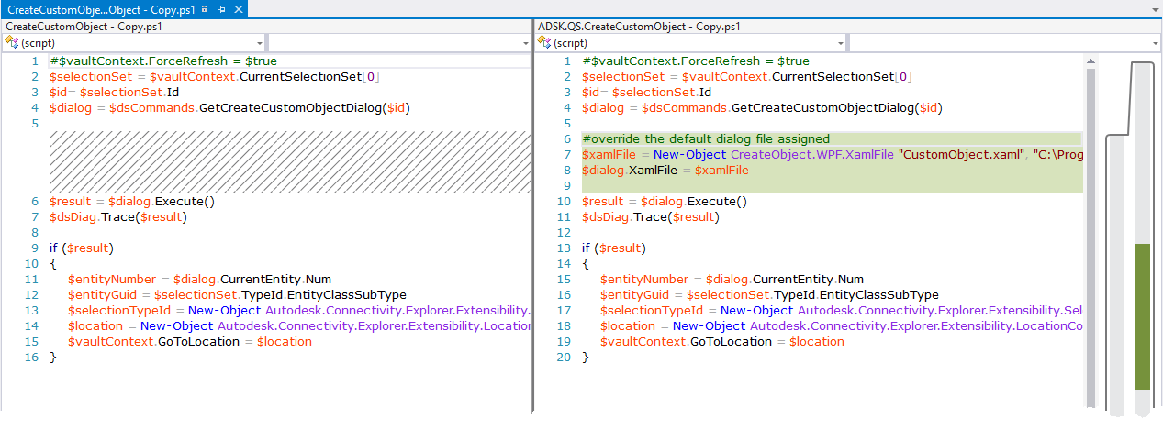
Quickstart 2019 | Compare Changes *Create*/*Edit*.ps1

Slide 21
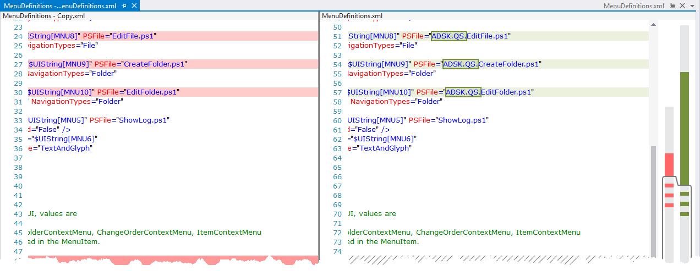
Quickstart 2019 | Compare Changes Menudefinition.xml

Slide 22
Best Practice Adding Customizations | Summary
Minimum Action – Separate Custom Configuration
Copy Default Script/Dialog File to .\*.Custom\* Locations
Optimum Actions – Encapsulate Custom Configuration
Copy & Rename Script/Dialog File to .\Custom\* Locations
Update all Relationships
Benefit – Unique names indicate individual functionality
Benefit – No risk to exchange configuration files just by name
Benefit – Easily edit & compare default & customized version

Slide 23
Evaluate Vault API

Slide 24
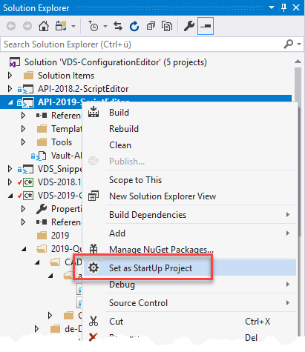
Evaluate Vault API | PowerShell Script
API-<Version>-ScriptEditor as StartUp
Copy Template
Edit Server / User Data
2018: Vault Client Installation required
2019: Select License Agent
Server: Script runs on machine without Vault
Client: Vault Client Installation required
None: ReadOnly Access
Add your code….

Slide 25
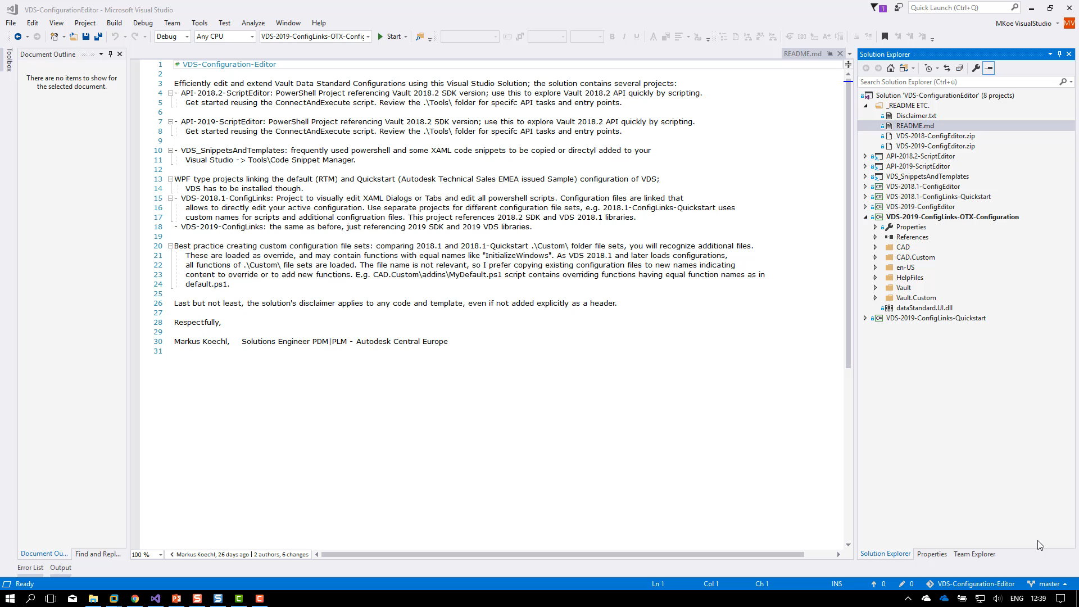
Evaluate Vault API | PowerShell Script
Example – Create Folder
Connect to Vault using LicenseAgent
Create Folder
Create Folder enforcing an error for review
During the video VS Code is used for PowerShell script execution – you could also use Visual Studio -> Run as Script

Slide 26
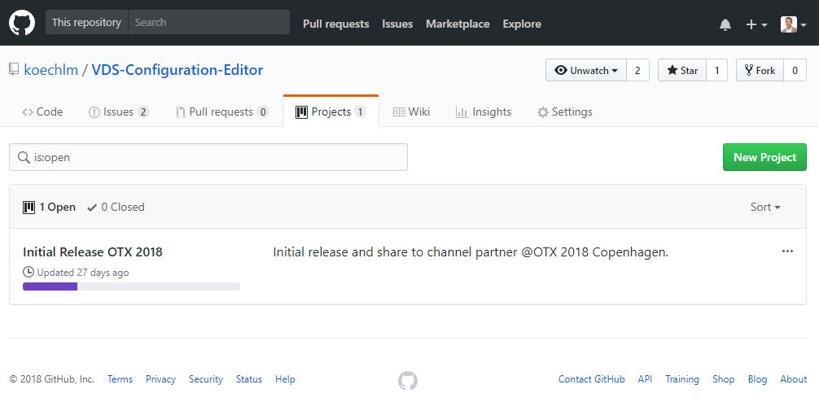
VDS Configuration Editor | Summary
Single source for templates, snippets and function samples
Always up to date – as it is Markus’ active editing environment
Follow on GitHub to stay tuned
Download partially the resources only
https://github.com/koechlm/VDS-Configuration-Editor

